Slide 2
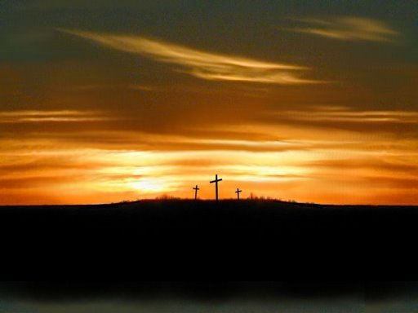
"see from His head, His hands, His feet, sorrow and love flowed mingled down; Did e'er such love and sorrow meet, Or thorns compose so rich a crown.“
Issac Watts 1707

Slide 3
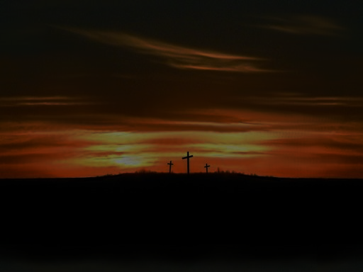
92 VERSES IN NEW TESTAMENT
Matthew 23 Verses
Mark 9 Verses
Luke 23 Verses
John 37 Verses
1 Corinthians 1:17 ...."lest the cross of Christ should be made of no effect."
1 Corinthians 1:23

Slide 4

“When I survey the wondrous cross….”
Wondrous.... “poetic/literary inspiring wonder” “A cause of surprise or astonishment; a marvel; abnormal occurrence.“
The Cross was no accident – Revelation 13:8
Christ spoke of His coming death – John 3:14; 18:4
“blood that was spilled upon the cross…” INCORRECT
Christ came into the world for this purpose – John 3:16
The cross should be the central point of our teaching
1 Corinthians 2:2-4 “Jesus Christ and Him crucified”
Galatians 6:14 “boast except in the cross…”

Slide 5
PARADOXES IN THE CROSS:
Most Tragic – Most Wonderful Event in History
Saddest Event – Out of it Came Great Joy
Greatest Manifestation of Hatred For Sin – Supreme Proof of His Love For The Sinner
Darkest Time In History – Time of Greatest Light
Human Vengeance “crucify Him, crucify Him.“ - Divine Forgiveness “Father forgive them for they know not what they do."

Slide 6

Three Styles of Roman Crosses

Slide 7
THE WONDER OF IT’S VICTIM
“The Passion of Christ From a Medical Point of View,” C. Truman Davis, M.D.
Christ is Understanding and Sympathetic – Luke 23:34
Christ Gave His Life Voluntarily For Us- John 10:17,18
He Had No Home of His Own- Matthew 8:20
Time Was Spent With Others – Acts 10:38

Slide 8
THE WONDER OF IT’S VICTIM
On The Cross His Thoughts & Concerns Were For Others
The Thief – Luke 23:43 “today you will be with Me in Paradise."
His Mother – John 19:26,27 "Woman, behold your son!"
His Executioners – Luke 23:34 “Father, forgive them, for they do not know what they do."

Slide 9
THE WONDER OF IT’S VICTIM
The Demonstration of Complete & Utter Obedience
Came to Do The Father’s Will – Luke 22:42 “not My will, but Yours, be done."
Hebrews 10:7 “'Behold, I have come…--To do Your will, O God.’”
Knew there was NO OTHER WAY to save YOU & ME
Could have called 10,000 angels – Hymn #537

Slide 10
A WONDERFUL ATTRACTION
Hymn #536 “The Old Rugged Cross” V.2 “Oh, that old rugged cross, so despised by the world, Has a wondrous attraction for me...”
Greatest display of love and sympathy – Romans 5:6-8
John 15:13 “"Greater love has no one than this, than to lay down one's life for his friends.

Slide 11
GREATEST EXHIBITION OF GRACE
2 Corinthians 8:9 “you know the grace of our Lord Jesus Christ, that though He was rich, …He became poor, …through His poverty might become rich.”
Humility- Philippians 2:5-8 “ the death of the cross.”
Release the greatest power ever displayed – Romans 1:16; 1 Corinthians 1:18
Greatest promise of salvation ever thought of- Hebrews 2:3 “how shall we escape…neglect so great a salvation”

Slide 12
"Greater love has no one than this, than to lay down one's life for his friends.”
John 15:13

Slide 13
1 Corinthians 11:27-29
Therefore whoever eats this bread or drinks this cup of the Lord in an unworthy manner will be guilty of the body and blood of the Lord. 28 But let a man examine himself, and so let him eat of the bread and drink of the cup. 29 For he who eats and drinks in an unworthy manner eats and drinks judgment to himself, not discerning the Lord's body.”

Slide 14
The Survey Of The Cross Of Christ Has The Power To Touch Even The Hardest Of Hearts
No Other Way To Salvation
Romans 6:3-10

Slide 15
